Slide 1
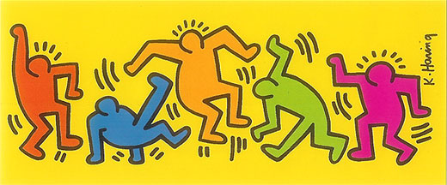
Pop Art (Keith Haring)

Slide 2
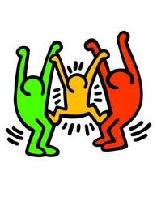

Slide 3
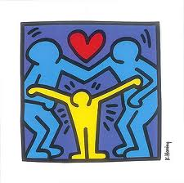

Slide 4
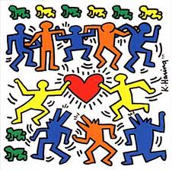

Slide 5
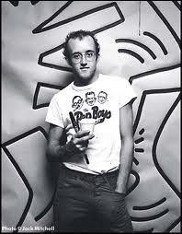
Keith Haring
Born: 1958 Pennsylvania, USA
Loved to draw cartoons from an early age, especially Walt Disney and Dr. Seuss.
Sold T-shirts, badges & fridge magnets in his NY shop because he wanted people to have low cost access to his work.
Created many art works for charities, hospitals and schools.
When he became sick with HIV/AIDS instead of hiding this he spoke out in public about the illness.
He died in 1990.

Slide 6
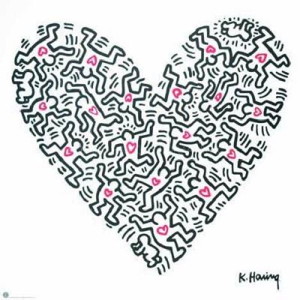
Images are from Google image Keith Haring children’s website- www.haringkids.com

Slide 7
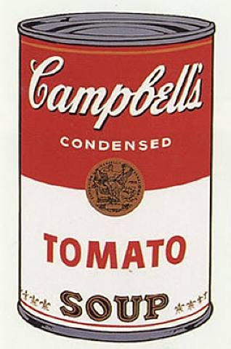
Other pop artists- Andy Warhol

Slide 8
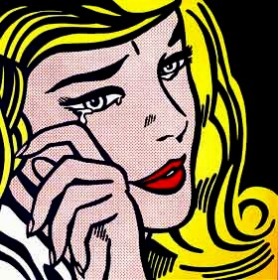
Other pop artists- Roy Liechtenstein

